Slide 1



GRADUATION THESIS
DEVELOPING A SMART AGRICULTURE
RECOMMENDATION SYSTEM BASED ON
MULTI-VARIABLE WEATHER FORECASTING MODELS
Students | : | Duong Tan Huy
 | : | Hoang Huu Tien Dat
Class | : | 21AD
Supervisor | : | MSc. Le Dinh Nguyen
Danang, January 2026

Slide 2
OUTLINE
Project Overview
Problem & Proposed Approach
System Analysis & Design
Technologies Used
System Design & Modeling
SYSTEM DEMONSTRATION
Evaluation & Future Development

Slide 3
PROJECT OVERVIEW
Background
Vietnam is an agriculture-based country where crop production heavily depends on weather conditions.
Climate change has increased weather variability, making accurate forecasting more challenging.
Existing forecasting systems mainly provide raw information and offer limited decision support for farmers.
Objectives
Develop a multivariate weather forecasting system for daily and hourly predictions.
Transform forecast results into actionable agricultural recommendations.
Integrate an AI chatbot to assist users with explanations and interactive consultation

Slide 4
PROBLEM & PROPOSED APPROACH
Existing Problems
Forecast accuracy is unstable under extreme and rapidly changing weather conditions.
Agricultural recommendation systems are often rigid and lack personalization.
Limited interpretability reduces user trust and usability.
Proposed Approach
Combine Machine Learning and Deep Learning for weather forecasting.
Apply multivariate time series models to capture complex weather relationships.
Develop crop- and growth-stage–aware agricultural recommendations.
Integrate an AI chatbot to provide explanations and interactive support

Slide 5
SYSTEM ANALYSIS & DESIGN
Actors
Agricultural User: Primary users who monitor weather, manage farming projects, and receive recommendations.
General User: General users who mainly access weather forecast information.
Admin: Responsible for system configuration, data, and user management.
Use Cases
User authentication.
View daily and hourly weather forecasts.
Manage farming projects and agricultural information.
Receive weather-based agricultural recommendations.
Interact with an AI chatbot for consultation and explanations.
Perform system administration tasks (Admin).

Slide 6








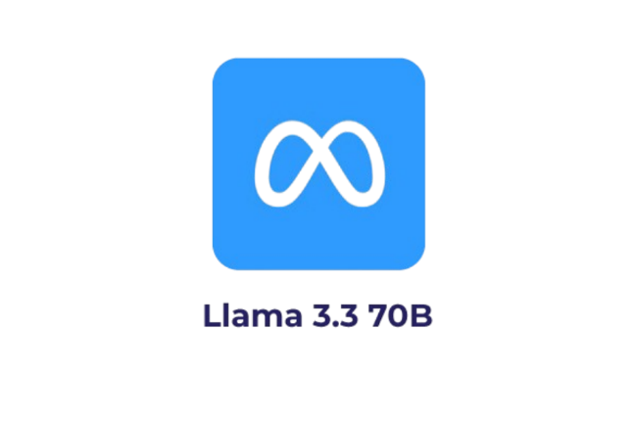

TECHNOLOGIES USED
Data Processing and Analysis Technologies:
Pandas, NumPy.
Scikit-learn, TensorFlow / Keras.
System & Deployment:
Backend: FastAPI
Frontend: ReactJS, TailwindCSS
Database: Supabase
Chatbot and Recommendation System: Llama-3.3-70B-Versatile

Slide 7
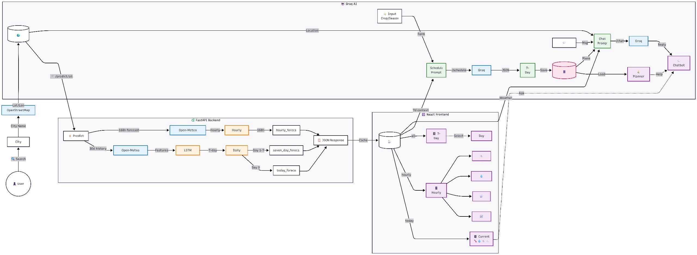
SYSTEM DESIGN & MODELING
System Overview

Slide 8
SYSTEM DESIGN & MODELING
Weather Forecasting Models
Daily Forecasting
VotingClassifier.
Combined models: XGBoost, LightGBM, Random Forest, Extra Trees.
Using Soft Voting for robustness.
Hourly Forecasting
HistGradientBoostingClassifier.
Suitable for large-scale, high-frequency data.
Fast training and inference.

Slide 9
SYSTEM DESIGN & MODELING
Multivariate Time Series Forecasting With LSTM
LSTM is applied to daily and hourly weather data.
Multiple weather-related variables are used as inputs.
Supports multi-step forecasting.
Forecast results are used by the recommendation system.

Slide 10
SYSTEM DESIGN & MODELING
Recommendation System & Chatbot
Agricultural Recommendation System
Inputs:
Weather forecast results.
Crop information and growth stages.
Outputs:
Context-aware farming recommendations.
Action-oriented schedules.
AI Chatbot
Explains forecast results and recommendations.
Provides interactive consultation and Q&A.
Improves system usability and user trust.

Slide 11
SYSTEM DEMONSTRATION

Slide 12
EVALUATION & FUTURE DEVELOPMENT
Achieved Results
Developed daily and hourly weather forecasting models.
Successfully implemented multivariate time series forecasting using LSTM.
Built a weather-based agricultural recommendation system.
Integrated an AI chatbot for consultation and explanation.
Completed a functional system demo.

Slide 13
EVALUATION & FUTURE DEVELOPMENT
Limitations
Weather data is limited and does not fully cover extreme conditions.
Model accuracy may decrease under highly unstable weather patterns.
The recommendation system has not been validated through long-term real-world deployment.
The chatbot lacks adaptive and self-learning capabilities.
System performance and scalability are still limited.

Slide 14
EVALUATION & FUTURE DEVELOPMENT
Future Development
Expand and diversify weather data sources, including IoT data.
Apply more advanced and pre-trained deep learning models.
Improve forecasting accuracy and model robustness.
Develop online learning mechanisms for the chatbot.
Optimize system performance and scalability.

Slide 15
EVALUATION & FUTURE DEVELOPMENT
Conclusion
This project developed a weather forecasting and agricultural recommendation system using Machine Learning, Deep Learning, and an AI chatbot.
The system supports agricultural decision-making and shows strong practical potential.
Future work includes multi-crop and multi-region support, personalized recommendations, real-world deployment, and evolving into a smart agriculture platform.

Slide 16
THANK YOU FOR YOUR LISTENING!

